Slide 1




Introduction to Hypothesis Testing and its Application in Real-Life and Data Science
Fatemeh Asgarinejad
fasgarinejad@ucsd.edu Slide 1 of 30 January 21, 2025
Notes:
Hi everyone, good morning. How’s everybody doing?
My name is Fatemeh Asgarinejad. I’m a fifth year PhD candidate at UCSD.
Today I’ll be talking about Hypothesis testing and its application in real life examples and a more concrete example in data science.

Slide 2


Announcements + schedule + links
Lectures
In person, SCHEDULE
Discussions
In person, SCHEDULE
Office Hours
SCHEDULES
Website| Piazza (Q&A) | Canvas (recordings + quizzes) | GradeScope (HW submission) | GitHub (code + slides) | Google Colab
HWs, HW solutions, due dates and exams.
fasgarinejad@ucsd.edu Slide 2 of 30 January 21, 2025
Notes:
code for data science example. practical. finding. our findings for hypothesis testing.

Slide 3
Course Plan: Where We Are Now
Week | Date | Topic | Activities
1 | Monday – Jan 6 | Combinatorics and Counting | HW 1 Programming 1 Exit Tickets 1-3
 | Wednesday – Jan 8 | Set Theory and Axioms of Statistics
 | Friday – Jan 10 | Conditional Probability and Bayes' Rule
2 | Monday – Jan 13 | Law of Total Probability, Independence, and Dependence | HW 2 Programming 2 Exit Tickets 4-6
 | Wednesday – Jan 15 | Conditional Independence, Chain Rule, Random Variables
 | Friday – Jan 17 | Probability Mass Function, Cumulative Distribution, Expectation, and Variance
3 | Monday – Jan 20 | Bernoulli and Binomial Distributions | Exam 1 Exit Tickets 7-9
 | Wednesday – Jan 22 | Geometric, Hypergeometric, and Poisson Distributions
 | Friday – Jan 24 | Continuous Random Variables, Uniform Distribution, Normal Distribution
4 | Monday – Jan 27 | Normal Distribution | HW 3 Programming 3 Exit Tickets 10-12
 | Wednesday – Jan 29 | Exponential Distribution and Its Memorylessness
 | Friday – Jan 31 | Joint Distribution
5 | Monday – Feb 3 | Conditional Joint Distribution, LOTUS | HW 4 Programming 4 Exit Tickets 13-15
 | Wednesday – Feb 5 | Covariance and Correlation
 | Friday – Feb 7 | Independent Random Variables
Week | Date | Topic | Activities
6 | Monday – Feb 10 | Central Limit Theorem | Exam 2 Exit Tickets 16-18 Project proposal
 | Wednesday – Feb 12 | Markov's Inequality, Chebyshev's Inequality, and Law of Large Numbers
 | Friday – Feb 14 | Conditional Expectation, Linearity of Expectation, Inverse Transform Method
7 | Monday – Feb 17 | Introduction to Statistics | HW 5 Programming 5 Exit Tickets 19-21
 | Wednesday – Feb 19 | Point Estimation and Maximum Likelihood Estimator
 | Friday – Feb 21 | Interval Estimation, Confidence Interval
8 | Monday – Feb 24 | Hypothesis Testing, z-Test, Fisher Test,p-Value | Project phase 1 Exit Tickets 22-24
 | Wednesday – Feb 26 | Project Phase 1 discussion
 | Friday – Feb 28 | Chi-squared Distribution and Test, t-Distribution and t-Test, p-value cont.
9 | Monday – March 3 | Nonparametric Tests, Permutation Test, p-Value Adjustment | HW 6 Programming 6 Exit Tickets 25-27
 | Wednesday – March 5 | Linear Regression
 | Friday – March 7 | Bayesian Inference, Maximum a Posteriori Method, and Conjugate Priors
10 | Monday – March 10 | Projects presentation and evaluation | Projects presentation and evaluation Final
 | Wednesday – March 12 | Projects presentation and evaluation
 | Friday – March 14 | Final
📌
fasgarinejad@ucsd.edu Slide 3 of 30 January 21, 2025
Notes:
So here’s the whole course syllabus and this is where we are now.

Slide 4
Today’s Learning Goals
Prerequisites: probability, distributions.
Introduction to Hypothesis Testing (Using statistics to evaluate some hypothesis/statement about a population)
What is a Hypothesis?
Null and Alternative Hypotheses
Decision Making
Test Statistics
Accept or reject Null Hypothesis
P-value
Specific Statistical Tests
Z-test
Fisher Exact Test
Errors in Hypothesis Testing
Type I and Type II errors
More Applications
Hypothesis Testing in Data Science
fasgarinejad@ucsd.edu Slide 4 of 30 January 21, 2025
Notes:
ta hours for background.
FEEL FREE TO ASK QUESTION

Slide 5


Practical Use Cases of Statistics (Election)
Predicting which of the USA presidency candidates will win the election.
We ask a sample of population and estimate which candidate is more likely to win based on their opinions.
President Trump will earn more electoral votes.
Former Vise-President Harris’s will earn more electoral votes.
Sample (poll here) can give us a good estimate about who is more probable to win the election.
images sources: first, second
fasgarinejad@ucsd.edu Slide 5 of 30 January 21, 2025
Notes:
I know that the more people I check the more the results will be similar to the actual election, but I don’t have the resources to ask 100k people for instance. How much confident can I be?
"z-test for proportions" is a statistical test used to determine if there is a significant difference between two population proportions based on sample data,
Poll Details:
Sample size (nnn): 1,000 voters
Respondents supporting Trump (XTrumpX_{\text{Trump}}XTrump​): 520
Respondents supporting Harris (XHarrisX_{\text{Harris}}XHarris​): 480
Step 1: Formulate the Hypotheses
Null Hypothesis (H0H_0H0​): pTrump=pHarrisp_{\text{Trump}} = p_{\text{Harris}}pTrump​=pHarris​ (both candidates have equal support).
Alternative Hypothesis (HaH_aHa​): pTrump≠pHarrisp_{\text{Trump}} \neq p_{\text{Harris}}pTrump​=pHarris​ (support is not equal for the two candidates).
Step 2: Calculate Sample Proportions
Proportion supporting Trump (p^Trump\hat{p}_{\text{Trump}}p^​Trump​):
p^Trump=XTrumpn=5201000=0.52\hat{p}_{\text{Trump}} = \frac{X_{\text{Trump}}}{n} = \frac{520}{1000} = 0.52p^​Trump​=nXTrump​​=1000520​=0.52
Proportion supporting Harris =0.48
Step 3: Compute the Test Statistic
The pooled proportion (p^\hat{p}p^​) is calculated as:
p^=XTrump+XHarrisn+n=520+4801000+1000=0.5\hat{p} = \frac{X_{\text{Trump}} + X_{\text{Harris}}}{n + n} = \frac{520 + 480}{1000 + 1000} = 0.5p^​=n+nXTrump​+XHarris​​=1000+1000520+480​=0.5The standard error (SE) is:
SE=p^⋅(1−p^)⋅(1n+1n)=0.5⋅0.5⋅(11000+11000)=0.02236SE = \sqrt{\hat{p} \cdot (1 - \hat{p}) \cdot \left(\frac{1}{n} + \frac{1}{n}\right)} = \sqrt{0.5 \cdot 0.5 \cdot \left(\frac{1}{1000} + \frac{1}{1000}\right)} = 0.02236SE=p^​⋅(1−p^​)⋅(n1​+n1​)​=0.5⋅0.5⋅(10001​+10001​)​=0.02236The Z-score is:
Z=p^Trump−p^HarrisSE=0.52−0.480.02236=1.79Z = \frac{\hat{p}_{\text{Trump}} - \hat{p}_{\text{Harris}}}{SE} = \frac{0.52 - 0.48}{0.02236} = 1.79Z=SEp^​Trump​−p^​Harris​​=0.022360.52−0.48​=1.79Step 4: Find the P-value
For a two-tailed test (Ha:pTrump≠pHarrisH_a: p_{\text{Trump}} \neq p_{\text{Harris}}Ha​:pTrump​=pHarris​), use a Z-table or calculator:
P(Z>1.79)≈0.0367P(Z > 1.79) \approx 0.0367P(Z>1.79)≈0.0367 for one tail.
Multiply by 2 for a two-tailed test: P=2⋅0.0367=0.0734P = 2 \cdot 0.0367 = 0.0734P=2⋅0.0367=0.0734
Step 5: Decision
If the significance level (α\alphaα) is 0.05, then P=0.0734>0.05P = 0.0734 > 0.05P=0.0734>0.05.
Fail to reject the null hypothesis: There is insufficient evidence to conclude that support for the two candidates is different based on the sample.

Slide 6
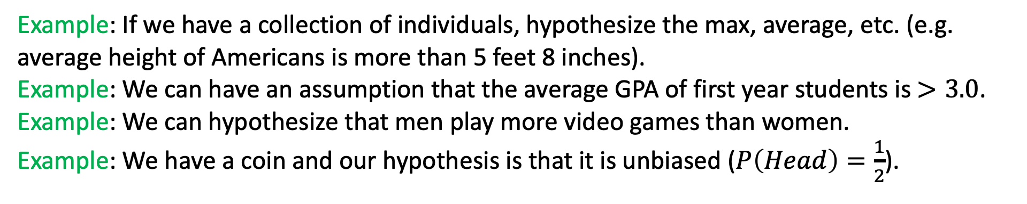
Hypothesis
A hypothesis is an assumption (statement) about parameters of a population or distribution that can be True or Not True.
Note: parameter is a numerical or measurable characteristic of a population, e.g., $average \left(μ\right), variance \left(σ^{2}\right), min, max, range, etc.$
Example: If we have a collection of individuals, hypothesize the max, average, etc. (e.g. average height of Americans is more than 5 feet 8 inches).
Example: We can have an assumption that the average GPA of first year students is $>3.0$.
Example: We can hypothesize that men play more video games than women.
Example: We have a coin and our hypothesis is that it is unbiased ($P\left(Head\right)=\frac{1}{2}$).
fasgarinejad@ucsd.edu Slide 6 of 30 January 21, 2025

Slide 7

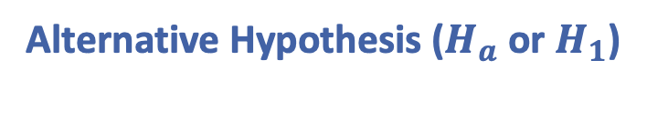

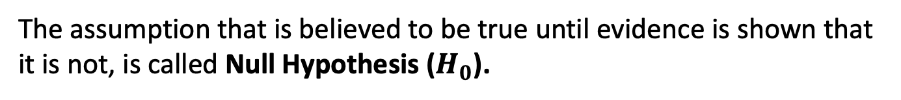
Null and Alternative Hypothesis
We aim to evaluate the effectiveness of a medicine on a group of patients (population) using a randomized clinical trial. We give the actual medicine to half of the participants, while the other half receive a placebo.
6 people
took medicine
6 people
took placebo
Medicine is not effective (has no effect on the outcome vs placebo)
Medicine is effective (there will be a difference between two populations).
Null Hypothesis ($H_{0}$)
Alternative Hypothesis ($H_{a}$ or $H_{1}$)
The assumption that is believed to be true until evidence is shown that it is not, is called Null Hypothesis ($H_{0}$).
The complementary (often) view is called Alternative Hypothesis ($H_{a}$ or $H_{1}$).
fasgarinejad@ucsd.edu Slide 7 of 30 January 21, 2025
Notes:
So, for introducing the null and alternative hypothesis we go with the example of Hypothesis Testing by a pharmasuducal company which wants to know if a medicine they have develpped is impactful or not.
This means the medicine has no real effect on the outcome compared to the placebo. Any observed difference between the groups is due to chance, not because the medicine works.
Note: Null Hypothesis and Alternative Hypothesis are mutually exclusive so only one can be true at a time but they are not necessarily complements as they might not account for all possibilities.

Slide 8

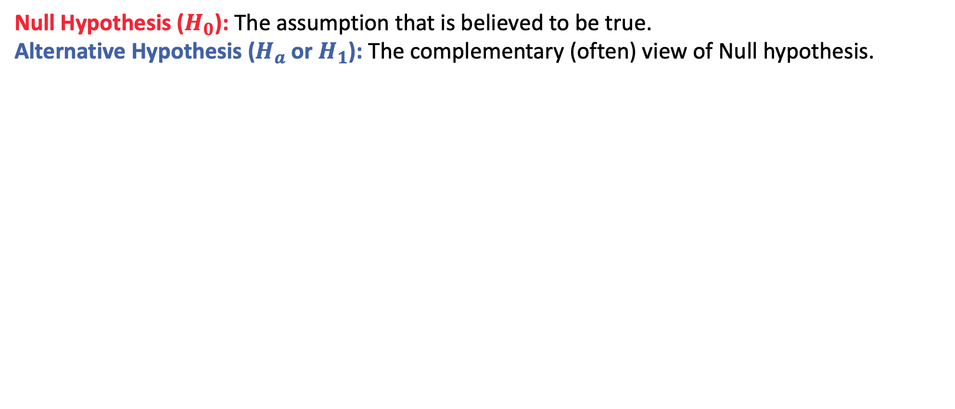
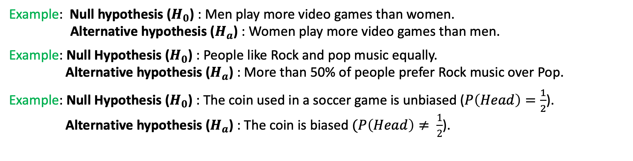
Null and Alternative Hypothesis
Null Hypothesis ($H_{0}$): The assumption that is believed to be true.
Alternative Hypothesis ($H_{a}$ or $H_{1}$): The complementary (often) view of Null hypothesis.
Discuss real-life scenarios of the null ${(H}_{0})$ and alternative hypotheses ($H_{1}$).
Example: Null hypothesis ($H_{0}$) : Men play more video games than women.
Alternative hypothesis ($H_{a}$) : Women play more video games than men.
Example: Null Hypothesis ($H_{0}$) : People like Rock and pop music equally.
Alternative hypothesis ($H_{a}$) : More than 50% of people prefer Rock music over Pop.
Example: Null Hypothesis ($H_{0}$) : The coin used in a soccer game is unbiased ($P\left(Head\right)=\frac{1}{2}$).
Alternative hypothesis ($H_{a}$) : The coin is biased$(P\left(Head\right)≠ \frac{1}{2}$).
fasgarinejad@ucsd.edu Slide 8 of 30 January 21, 2025
Notes:
Now, I’m asking you to name some real-life scenarios of null and alternative hypothesis.

Slide 9
Test Statistics
6 people
took medicine
6 people
took placebo
# cured , # not cured
after 1 month
# cured, # not cured
Which characteristic(s) should we study to measure the medicine's impact?
Test statistics is a function of sample data (mean, standard deviation, count, etc.) that helps us determine whether we should reject the Null Hypothesis or not.
fasgarinejad@ucsd.edu Slide 9 of 30 January 21, 2025
Notes:
In this example, test statistics can be number of cured patients in a group that is a measurable factor for evaluating medicine’s effectiveness.

Slide 10

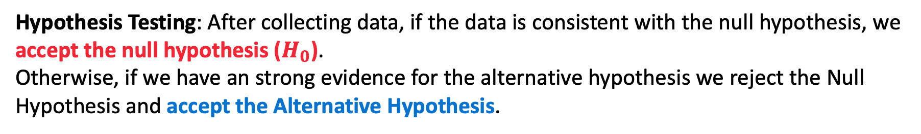
Hypothesis Testing
6 people
took medicine
6 people
took placebo
4 cured , 2 not cured
after 1 month
1 cured, 5 not cured
Medicine is not effective. Null Hypothesis ($H_{0}$)
Medicine is effective (there will be a difference between two populations).
Alternative Hypothesis ($H_{a}$ or $H_{1}$)
Hypothesis Testing: After collecting data, if the data is consistent with the null hypothesis, we accept the null hypothesis ($H_{0}$).
Otherwise, if we have an strong evidence for the alternative hypothesis we reject the Null Hypothesis and accept the Alternative Hypothesis.
fasgarinejad@ucsd.edu Slide 10 of 30 January 21, 2025
Notes:
6 cured, 2 not cured. so it seems that we have found strong evidence for the alternative hypothesis that says

Slide 11
Hypothesis Testing
6 people
took medicine
6 people
took placebo
4 cured , 2 not cured
after 1 month
1 cured, 5 not cured
Should we allow the pharmaceutical company to release the medicine?
Is it possible to observe 4 cured , 2 not cured in the population who took placebo? Or is the observed result statistically significant to reject the Null Hypothesis?
Should we set a threshold for rejecting the Null Hypothesis ($H_{0}$)?
fasgarinejad@ucsd.edu Slide 11 of 30 January 21, 2025
Notes:
and what this threshold be?

Slide 12
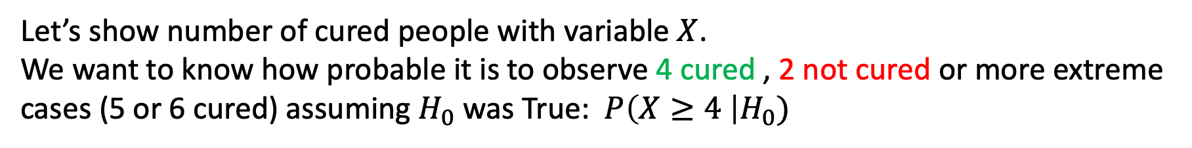
P-value (probability value)
6 people
took medicine
6 people
took placebo
4 cured , 2 not cured
after 1 month
1 cured, 5 not cured
Let’s show number of cured people with variable $X$.
We want to know how probable it is to observe 4 cured , 2 not cured or more extreme cases (5 or 6 cured) assuming $H_{0}$ was True: $P\left(X≥4 \right|H_{0})$
Remember: Null Hypothesis ($H_{0}):$Medicine is not effective (there is no difference between two populations and any observed difference is due to chance or other factors rather than medicine)
Does the pharmaceutical company want $P\left(X≥4 | H_{0}\right)$ be high or low?
fasgarinejad@ucsd.edu Slide 12 of 30 January 21, 2025
Notes:
XXX. MORE TIME
INTUITIVELY, how probable it is to observe such extreme results if the medicine was not impactful
becuase if this is high it means even if tthe mdicien is not impactful, we can
P-value IS ALL ABOUT THIS essentially p-value is inform us how probable that extreme case is even if null hypothesis was correct.
so if p-value is high, observing such results is due to some randomness.

Slide 13
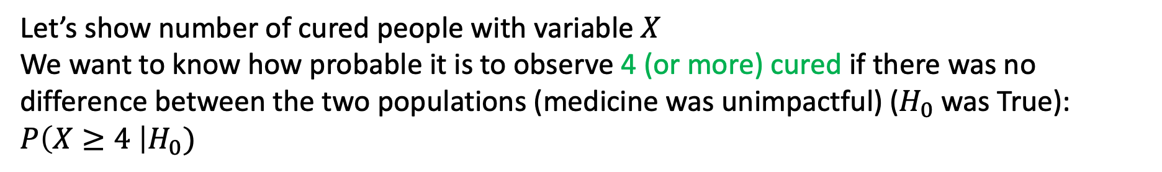
Significance Level
6 people
took medicine
6 people
took placebo
4 cured , 2 not cured
after 1 month
1 cured, 5 not cured
Let’s show number of cured people with variable $X$
We want to know how probable it is to observe 4 (or more) cured if there was no difference between the two populations (medicine was unimpactful) ($H_{0}$ was True): $P\left(X≥4 \right|H_{0})$
$$P\left(X≥threshold \right|H_{0})≤α$$
significance level ($α$) is the probability of mistakenly rejecting $H_{0}$. $Note:$ significance level is often set to be 1% or 5%.
fasgarinejad@ucsd.edu Slide 13 of 30 January 21, 2025
Notes:
a significance level of 0.05 indicates a 5% risk of concluding that a difference exists between the two populations when there is no actual difference.
For example, if the p-value is 0.01 and α = 0.05, we would reject the null hypothesis. However, there is still a small chance (5%) that this extreme result could occur even if the null hypothesis is true. This reflects the 5% chance we are willing to accept of making a Type I error.

Slide 14
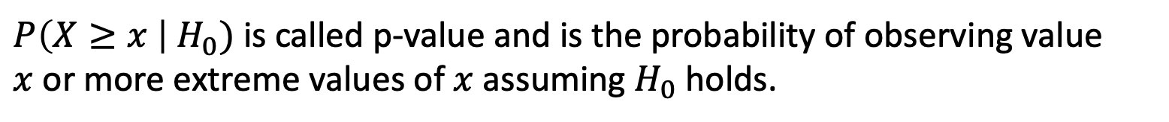
P-value
6 people
Took medicine
6 people
Took placebo
after 1 month
4 cured , 2 not cured
after 1 month
1 cured, 5 not cured
If $P\left(X≥threshold\right|H_{0})≤α,$ we can reject ${Null Hypothesis (H}_{0})$ with $1−α$ confidence.
$P\left(X≥x \right| H_{0})$ is called p-value and is the probability of observing value $x$or more extreme values of $x$ assuming $H_{0}$ holds.
Later in the slides: Fisher Exact Test
fasgarinejad@ucsd.edu Slide 14 of 30 January 21, 2025
Notes:
If p-value is 0.01, if the H0 is true, the chances of observing what we observed or more extreme results, is only 1%. Given what we observed, it is much more likely that the null hypothesis is false. it would be incredibly unusuall to obsereve such results if the drug did not really work.
if this p-value is less than 5% for instance, then our results are significant and we can accept the alternative hypothesis.
On the other hand if P-value is 0.6, if the H0 is true, the chances of observing what we observed is 60%. So it is very likely to observe what we observed even if the medicine does not do anything at all. So the smaller the p-value is the more confidence wee have in rejecting the null hypothesis. https://www.youtube.com/watch?v=DAkJhY2zQ3c
Ronald fisher, 0.05 is just a convention.

Slide 15
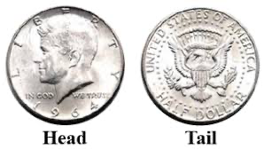
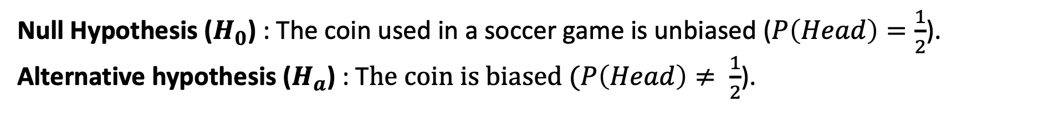
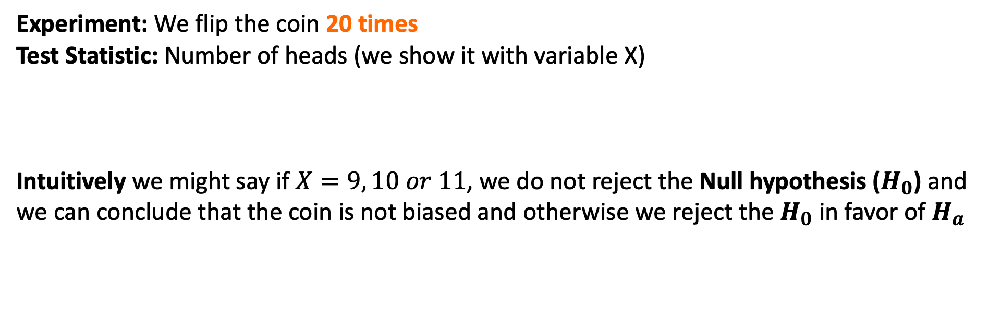
Testing the Hypothesis - P-value
Null Hypothesis ($H_{0}$) : The coin used in a soccer game is unbiased ($P\left(Head\right)=\frac{1}{2}$).
Alternative hypothesis ($H_{a}$) : T$he coin is biased (P\left(Head\right)≠ \frac{1}{2}$).
Experiment: We flip the coin 20 times
Test Statistic: Number of heads (we show it with variable X)
Intuitively we might say if $X=9, 10 or 11$, we do not reject the Null hypothesis ($H_{0}$) and we can conclude that the coin is not biased and otherwise we reject the $H_{0}$ in favor of $H_{a}$
With what range of X can I claim with 95% confidence that the coin is unbiased?
fasgarinejad@ucsd.edu Slide 15 of 30 January 21, 2025
Notes:
16 times head and with 95% confidence is biased.
Once the distribution of the sample statistic under the null hypothesis is determined, to complete the stochastic proof by contradiction, you simply need to ask: Given this distribution, how likely is it that I would have drawn a random sample in which the estimated value is this extreme or more extreme?
This is the p-value: The probability of your observing an estimate as extreme as the one you observed if the null hypothesis is true. If this p-value is small, it means that this data is unlikely to occur under the null hypothesis, and thus the null hypothesis is unlikely to be true. (See, proof by contradiction!)

Slide 16
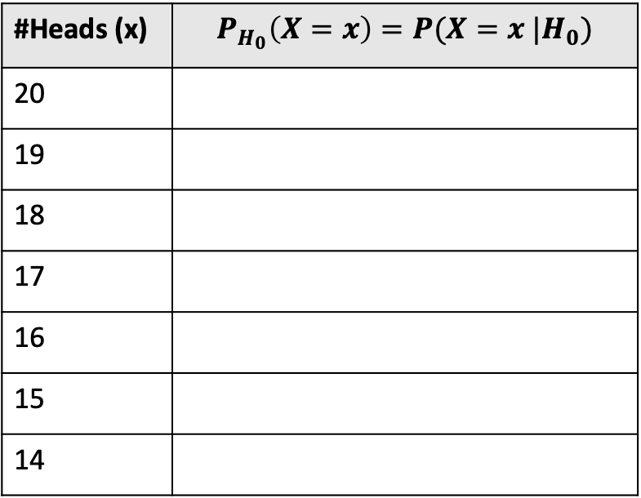
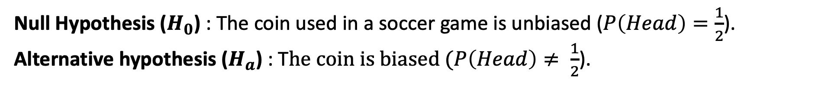
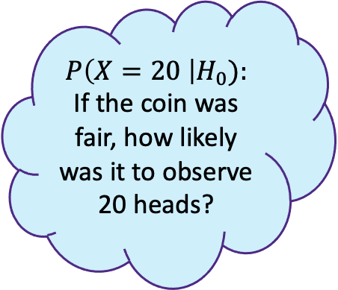
Testing the Hypothesis - P-value
Null Hypothesis ($H_{0}$) : The coin used in a soccer game is unbiased ($P\left(Head\right)=\frac{1}{2}$).
Alternative hypothesis ($H_{a}$) : T$he coin is biased (P\left(Head\right)≠ \frac{1}{2}$).
#Heads (x) | $$P_{H_{0}}\left(X=x\right)=P(X=x |H_{0})$$
20
19
18
17
16
15
14
$$P\left(X=20 \right|H_{0}):$$ If the coin was fair, how likely was it to observe 20 heads?
fasgarinejad@ucsd.edu Slide 16 of 30 January 21, 2025
Notes:
If the coin was fair, how likely is it to get 20 heads?
1 in a million

Slide 17
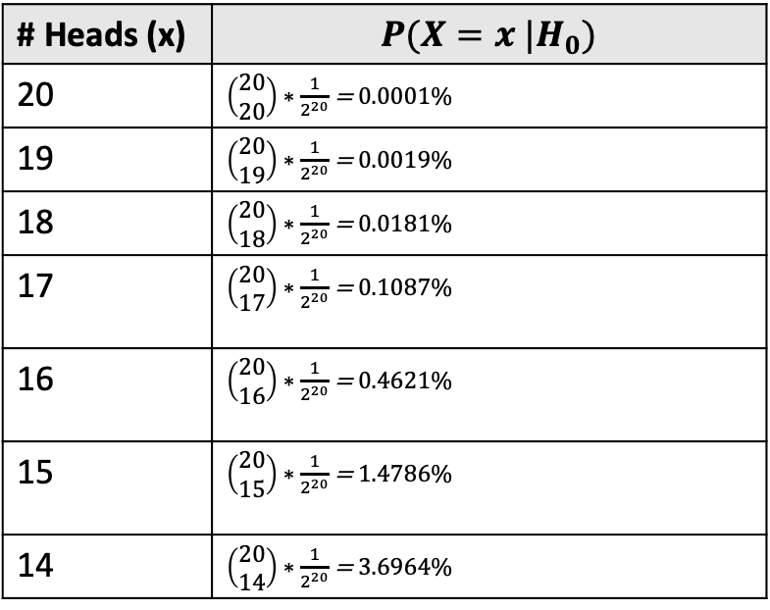
Testing the Hypothesis - P-value
Null Hypothesis ($H_{0}$) : The coin used in a soccer game is unbiased ($P\left(Head\right)=\frac{1}{2}$).
Alternative hypothesis ($H_{a}$) : T$he coin is biased (P\left(Head\right)≠ \frac{1}{2}$).
# Heads (x) | $$P(X=x |H_{0})$$
20 | $\left(\begin{matrix}20 \\ 20\end{matrix}\right)∗\frac{1}{2^{20}}$ = 0.0001%
19 | $\left(\begin{matrix}20 \\ 19\end{matrix}\right)∗\frac{1}{2^{20}}$ = 0.0019%
18 | $\left(\begin{matrix}20 \\ 18\end{matrix}\right)∗\frac{1}{2^{20}}$ = 0.0181%
17 | $\left(\begin{matrix}20 \\ 17\end{matrix}\right)∗\frac{1}{2^{20}}$ = 0.1087%
16 | $\left(\begin{matrix}20 \\ 16\end{matrix}\right)∗\frac{1}{2^{20}}$ = 0.4621%
15 | $\left(\begin{matrix}20 \\ 15\end{matrix}\right)∗\frac{1}{2^{20}}$ = 1.4786%
14 | $\left(\begin{matrix}20 \\ 14\end{matrix}\right)∗\frac{1}{2^{20}}$ = 3.6964%
20, 0
19, 1
18, 2
17, 3
16, 4
15, 5
14, 6
fasgarinejad@ucsd.edu Slide 17 of 30 January 21, 2025
Notes:
So here’s the probabilities of observing each of the number of heads. For instance it is only 3.69% possible to observe 14 heads out of 20.

Slide 18
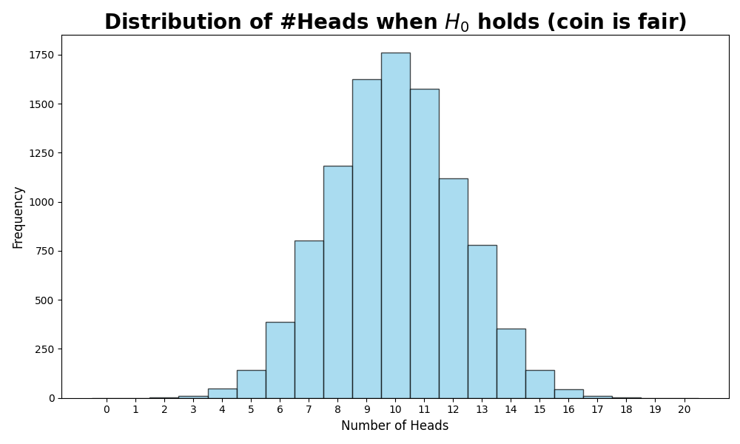
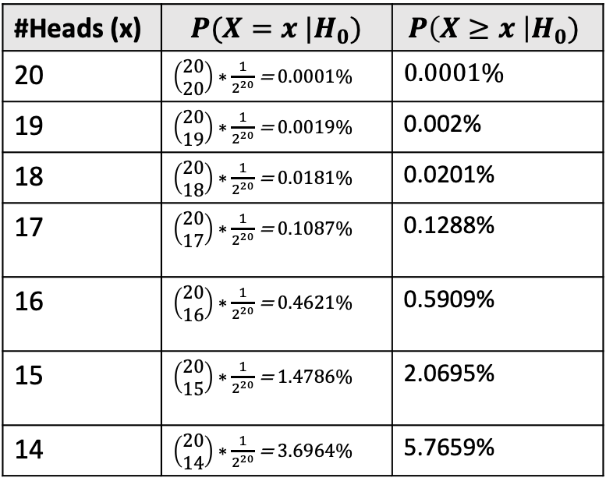
Testing the Hypothesis - P-value
Null Hypothesis ($H_{0}$) : The coin used in a soccer game is unbiased ($P\left(Head\right)=\frac{1}{2}$).
Alternative hypothesis ($H_{a}$) : T$he coin is biased (P\left(Head\right)≠ \frac{1}{2}$).
#Heads (x) | $$P(X=x |H_{0})$$ | $$P\left(X≥x \right|H_{0})$$
20 | $\left(\begin{matrix}20 \\ 20\end{matrix}\right)∗\frac{1}{2^{20}}$ = 0.0001% | 0.0001%
19 | $\left(\begin{matrix}20 \\ 19\end{matrix}\right)∗\frac{1}{2^{20}}$ = 0.0019% | 0.002%
18 | $\left(\begin{matrix}20 \\ 18\end{matrix}\right)∗\frac{1}{2^{20}}$ = 0.0181% | 0.0201%
17 | $\left(\begin{matrix}20 \\ 17\end{matrix}\right)∗\frac{1}{2^{20}}$ = 0.1087% | 0.1288%
16 | $\left(\begin{matrix}20 \\ 16\end{matrix}\right)∗\frac{1}{2^{20}}$ = 0.4621% | 0.5909%
15 | $\left(\begin{matrix}20 \\ 15\end{matrix}\right)∗\frac{1}{2^{20}}$ = 1.4786% | 2.0695%
14 | $\left(\begin{matrix}20 \\ 14\end{matrix}\right)∗\frac{1}{2^{20}}$ = 3.6964% | 5.7659%
reject the Null Hypothesis
accept the Null Hypothesis
reject the Null Hypothesis
fasgarinejad@ucsd.edu Slide 18 of 30 January 21 2025
Notes:
But extreme case is not limited to this,
So here’s the probabilities of observing each of the number of heads. For instance it is only 3.69% possible to observe 14 heads out of 20.

Slide 19
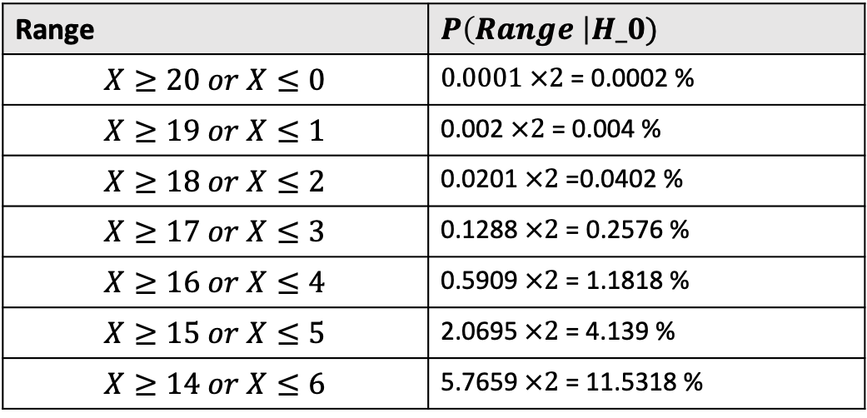
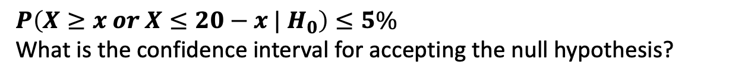
Testing the Hypothesis - P-value
Null Hypothesis ($H_{0}$) : The coin used in a soccer game is unbiased ($P\left(Head\right)=\frac{1}{2}$).
Alternative hypothesis ($H_{a}$) : T$he coin is biased (P\left(Head\right)≠ \frac{1}{2}$).
Range | $P\left(Range \right|H_0)$
$$X≥20 or X≤0$$ | 0.0001 $×2$ = 0.0002 %
$$X≥19 or X≤1$$ | 0.002 $×2$ = 0.004 %
$$X≥18 or X≤2$$ | 0.0201 $×2$ =0.0402 %
$$X≥17 or X≤3$$ | 0.1288 $×2$ = 0.2576 %
$$X≥16 or X≤4$$ | 0.5909 $×2$ = 1.1818 %
$$X≥15 or X≤5$$ | 2.0695$×2$ = 4.139 %
$$X≥14 or X≤6$$ | 5.7659$×2$ = 11.5318 %
$$P\left(X≥x or X≤20−x | H_{0}\right)≤5\%$$
What is the confidence interval for accepting the null hypothesis?
$$5≤x≤15$$
reject the Null Hypothesis
accept the Null Hypothesis
reject the Null Hypothesis
fasgarinejad@ucsd.edu Slide 19 of 30 January 21, 2025
Notes:
can you tell me what is the area in the distribution?

Slide 20
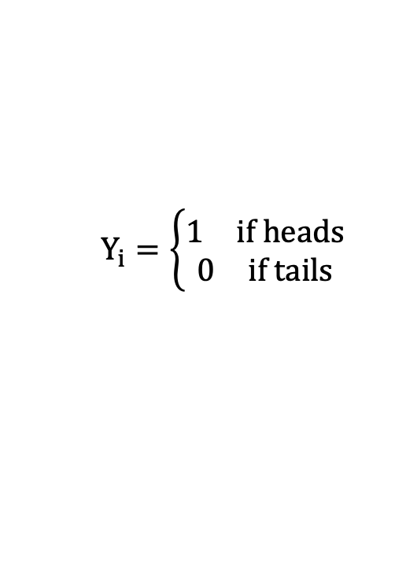
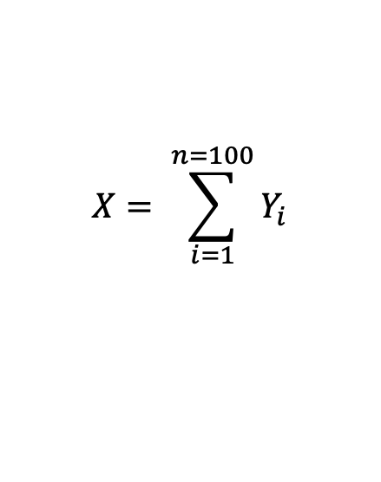
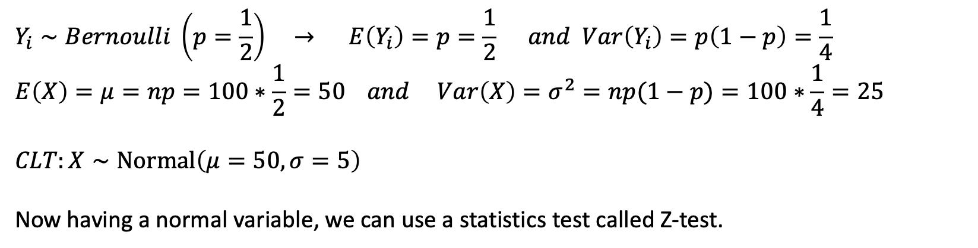
Z-test (when the sample size is large enough)
Null Hypothesis ($H_{0}$) : The coin used in a soccer game is unbiased ($P\left(Head\right)=\frac{1}{2}$).
Alternative hypothesis ($H_{a}$) : T$he coin is biased (P\left(Head\right)≠ \frac{1}{2}$).
$$Y_{i}=\left\{\begin{matrix}\begin{matrix}1 & if heads\end{matrix} \\ \begin{matrix}0 & if tails\end{matrix}\end{matrix}\right.$$
$$X= \sum_{i=1}^{n=100}{Y_{i}}$$
$$Y_{i}∼Bernoulli \left(p=\frac{1}{2}\right) → E\left(Y_{i}\right)=p=\frac{1}{2} and Var\left(Y_{i}\right)=p\left(1−p\right)=\frac{1}{4}$$
$$E\left(X\right)=μ=np=100∗\frac{1}{2}=50 and Var\left(X\right)=σ^{2}=np(1−p)=100∗\frac{1}{4}=25$$
$$CLT:X∼Normal\left(μ=50, σ=5\right)$$
Now having a normal variable, we can use a statistics test called Z-test.
fasgarinejad@ucsd.edu Slide 20 of 30 January 21, 2025
Notes:
our test statistic is set to X which is summation of some flippings that each could be 0 if tails and 1 heads
If h0 holds true then each of these yis follows a Bernoulli distribution with p=1/2 and we know expected and variance. Now based on above, the expected and variance of X can be calculated. Now we can use central limit theorem as the number of flipping the coins is large and we know that we are summing up some idependent varianbls yis to create X and when we do this experiment multiple times, X follows a normal distribution.
https://learning.edx.org/course/course-v1:UCSanDiegoX+DSE210x+3T2024/block-v1:UCSanDiegoX+DSE210x+3T2024+type@sequential+block@619ad06b4eb840179310a6aa361e8803/block-v1:UCSanDiegoX+DSE210x+3T2024+type@vertical+block@c4494a7e71bd4ae0ba5a12a0fa35fda4
We first convert $X$to a standard normal variable $Z=\frac{X−μ}{σ}=\frac{X −50}{5}$
Now $Z∼Normal(0, 1)$
حال Z یک متغیر نرمال استاندارد است. برای Z بازه‌ی اطمینان 95% را میابیم. همانطور که میدانید بازه‌ی اطمینان 95% نشان دهنده‌ی ناحیه‌ای است که اگر از متغیری که از توزیع نرمال استاندارد پیروی میکند نمونه‌ای بگیریم، به احتمال 95 درصد در این بازه می‌افتد:
It states that the distribution of the sum (or average) of a large number of independent, identically distributed (i.i.d.) random variables will approximate a normal distribution
The z-test can be used when the sample size is large enough that the binomial distribution can be approximated by the normal distribution
A Bernoulli distribution is for a single trial or experiment that has only two possible outcomes: success (usually denoted as 1) or failure (denoted as 0).
What it is: A Binomial distribution is for experiments where you repeat the same Bernoulli trial multiple times (say, nnn times), and you're interested in how many successes (1's) happen out of those nnn trials.

Slide 21
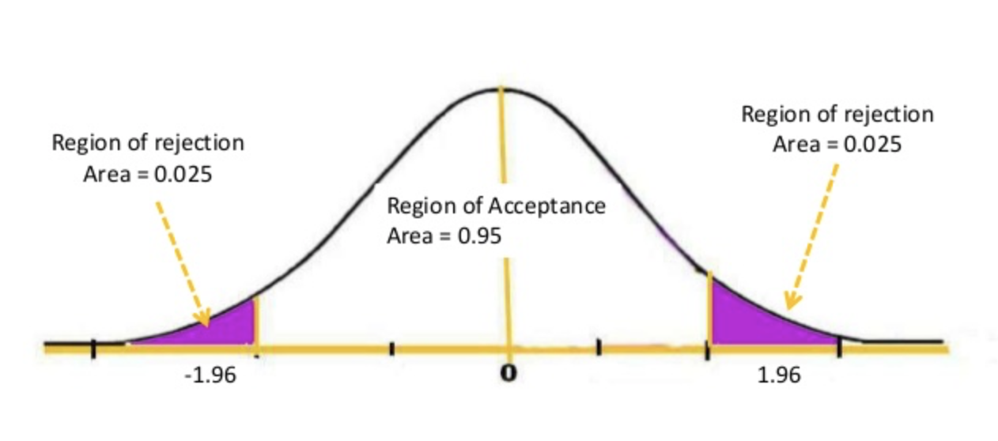
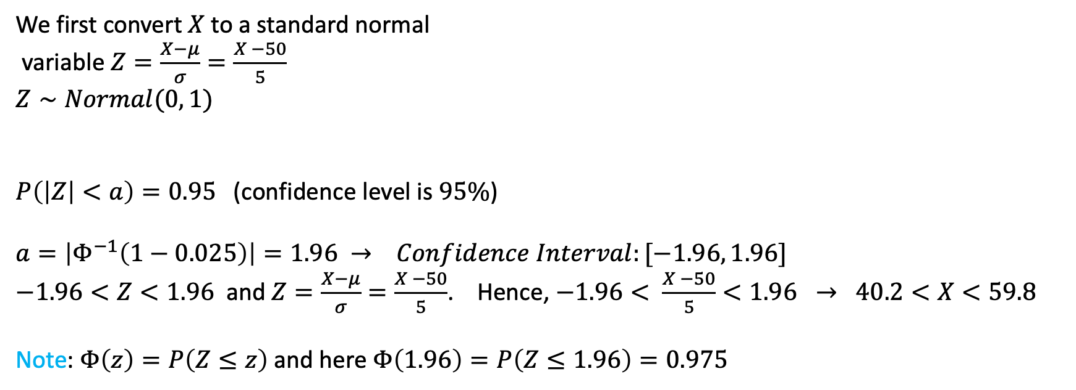
Z-test (when the sample size is large enough)
Null Hypothesis ($H_{0}$) : The coin used in a soccer game is unbiased ($P\left(Head\right)=\frac{1}{2}$).
Alternative hypothesis ($H_{a}$) : T$he coin is biased (P\left(Head\right)≠ \frac{1}{2}$).
We first convert $X$to a standard normal variable $Z=\frac{X−μ}{σ}=\frac{X −50}{5}$
$Z∼Normal(0, 1)$
$P\left(\left|Z\right|<a\right)=0.95$ (confidence level is $95\%$)
$$a=\left|Φ^{−1}\left(1−0.025\right)\right|=1.96 → Confidence Interval:[−1.96, 1.96]$$
$−1.96<Z<1.96$ and $Z=\frac{X−μ}{σ}=\frac{X −50}{5}$. Hence, $−1.96< \frac{X −50}{5}<1.96 → 40.2<X<59.8$
Note: $Φ\left(z\right)=P\left(Z≤z\right)$and here $Φ\left(1.96\right)=P\left(Z≤1.96\right)=0.975$
fasgarinejad@ucsd.edu Slide 21 of 30 January 21, 2025
Notes:
The CDF of the standard normal distribution, denoted by Φ(x)\Phi(x)Φ(x), gives the probability that a standard normal random variable (with mean 0 and standard deviation 1) is less than or equal to a certain value xxx.Mathematically, Φ(x)=P(Z≤x)\Phi(x) = P(Z \leq x)Φ(x)=P(Z≤x), where ZZZ is a standard normal random variable.
The inverse of Φ(x)\Phi(x)Φ(x), written as Φ−1(x)\Phi^{-1}(x)Φ−1(x), answers the question: "For a given probability xxx, what is the value of ZZZ such that the probability of ZZZ being less than or equal to that value is xxx?”
Z follows a normal distribution with
if H0 holds, meaning the coin is unbiasd, with 95% confidence z is between which two numbers? -a < Z < a
0.025 and 0.025 as this distribution is symmetric.
phay -1 of
the inverse of the standard normal cumulative distribution function (CDF), $\Phi(x)$.
Φ−1(p) is the inverse CDF (also called the quantile function) of the standard normal distribution. Φ−1(p) is the value of z for which the area under the standard normal curve to the left of z is equal to ppp.

Slide 22
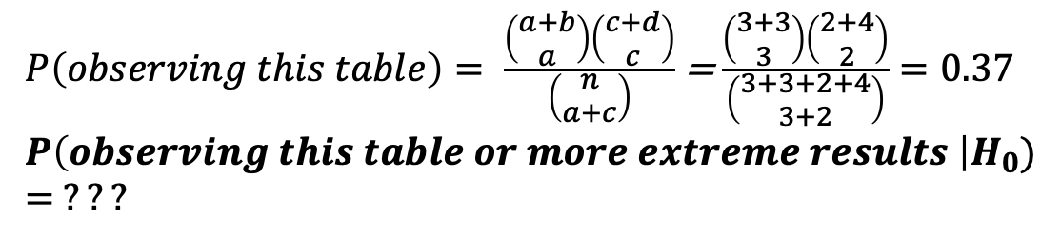
Fisher’s Exact Test
6 people
Took medicine
6 people
Took placebo
after 1 month
3 cured , 3 not cured
50% of people got cured
after 1 month
2 cured, 4 not cured 33% of people got cured
If $P\left(X≥threshold\right|H_{0})≤α,$ we can reject $H_{0}$ with $1−α$ confidence.
 | cured | Not cured | Total
Took medicine | 3 = a | 3 = b | a + b
Took placebo | 2 = c | 4 = d | c + d
Total | a + c | b + d | n
$P\left(observing this table\right)= \frac{\left(\begin{matrix}a+b \\ a\end{matrix}\right)\left(\begin{matrix}c+d \\ c\end{matrix}\right)}{\left(\begin{matrix}n \\ a+c\end{matrix}\right)}$=$\frac{\left(\begin{matrix}3+3 \\ 3\end{matrix}\right)\left(\begin{matrix}2+4 \\ 2\end{matrix}\right)}{\left(\begin{matrix}3+3+2+4 \\ 3+2\end{matrix}\right)}=0.37$
$$P\left(observing this table or more extreme results \right|H_{0})= ???$$
fasgarinejad@ucsd.edu Slide 22 of 30 January 21, 2025
Notes:
It means there’s a 37% chance of seeing results this extreme or more if H0​ is true
Note: $H_{0}$ in Fisher’s exact test is that columns and rows are independent. Meaning, if a person got the medicine or not it does not impact them being cured.
For large samples, Fisher's test can be computationally intensive, and the chi-squared test often gives similar results.Fisher's test is more conservative and may have less power in large datasets.

Slide 23
Fisher’s Exact Test
6 people
Took medicine
6 people
Took placebo
after 1 month
3 cured , 3 not cured
after 1 month
2 cured, 4 not cured
insufficient evidence to reject the null hypothesis
$$P\left(observing this table or more extreme results \right|H_{0})≫0.05$$
 | cured | Not cured
Took medicine | 3 = a | 3 = b
Took placebo | 2 = c | 4 = d
 | cured | Not cured
Took medicine | 5 = a | 1 = b
Took placebo | 2 = c | 4 = d
 | cured | Not cured
Took medicine | 4 = a | 2 = b
Took placebo | 2 = c | 4 = d
 | cured | Not cured
Took medicine | 6 = a | 0 = b
Took placebo | 2 = c | 4 = d
fasgarinejad@ucsd.edu Slide 23 of 30 January 21, 2025
Notes:
It means there’s a 37% chance of seeing results this extreme or more if H0​ is true
Note: $H_{0}$ in Fisher’s exact test is that columns and rows are independent. Meaning, if a person got the medicine or not it does not impact them being cured.
For large samples, Fisher's test can be computationally intensive, and the chi-squared test often gives similar results.Fisher's test is more conservative and may have less power in large datasets.

Slide 24
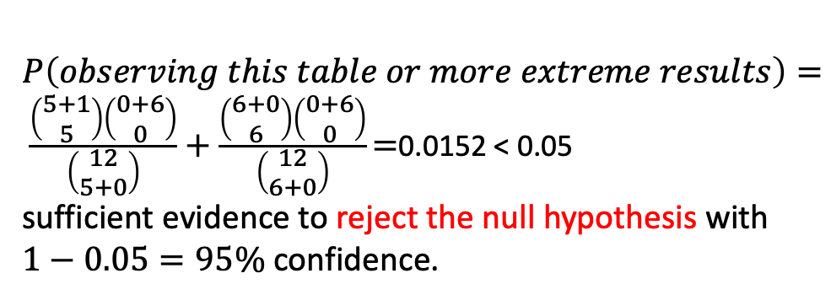
Fisher’s Exact Test
6 people
Took medicine
6 people
Took placebo
after 1 month
5 cured , 1 not cured
after 1 month
0 cured, 6 not cured
If $P\left(X≥threshold\right|H_{0})≤α,$ we can reject $H_{0}$ with $1−α$ confidence.
 | cured | Not cured | Total
Took medicine | 5 = a | 1 = b | a + b
Took placebo | 0 = c | 6 = d | c + d
Total | a + c | b + d | n
$P\left(observing this table or more extreme results\right)= \frac{\left(\begin{matrix}5+1 \\ 5\end{matrix}\right)\left(\begin{matrix}0+6 \\ 0\end{matrix}\right)}{\left(\begin{matrix}12 \\ 5+0\end{matrix}\right)}+\frac{\left(\begin{matrix}6+0 \\ 6\end{matrix}\right)\left(\begin{matrix}0+6 \\ 0\end{matrix}\right)}{\left(\begin{matrix}12 \\ 6+0\end{matrix}\right)}\text{=}\text{0.0152}\text{ < 0.05}$
sufficient evidence to reject the null hypothesis with $1−0.05=95\%$ confidence.
fasgarinejad@ucsd.edu Slide 24 of 30 January 21, 2025
Notes:
It means there’s a 3.9% chance of seeing results this extreme if H0​ is true

Slide 25
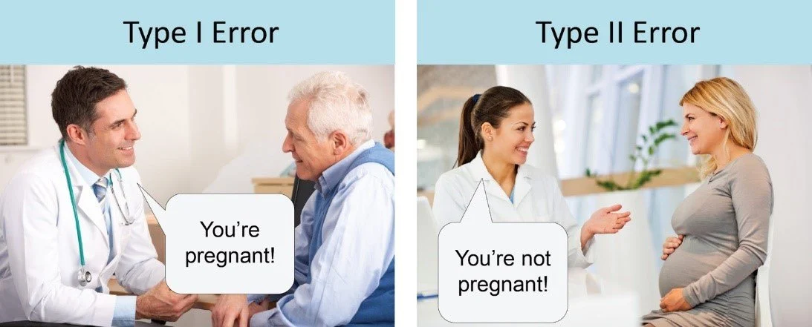
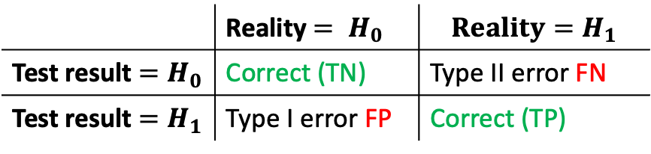
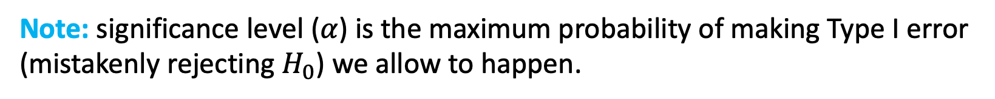
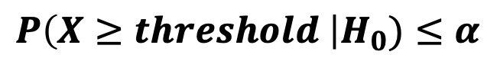
Type I and Type II Error
$$P\left(X≥threshold \right|H_{0})≤α$$
Note: significance level ($α$) is the maximum probability of making Type I error (mistakenly rejecting $H_{0}$) we allow to happen.
 | Reality $= H_{0}$ | $${Reality=H}_{1}$$
Test result $=H_{0}$ | Correct (TN) | Type II error FN
Test result ${=H}_{1}$ | Type I error FP | Correct (TP)
False Positive
False Negative
fasgarinejad@ucsd.edu Slide 25 of 30 January 21, 2025
Notes:
آزمون فرض ممکن است دچار دو نوع خطا شود: 1- خطای نوع اول (α) 2- خطای نوع دوم (β) Significance level shows how comfortable we are in making type 1 error., if significance level is 5% and we mistakenly reject H0, then we are saying there is some difference between two populations. So in when we were defining p-value, this p-value showed that the extreme results we observed were in fact by luck. So, if H0 was actually correct, and we mistakenly say H1 is correct, we are making Type 1 error that is called false positive.

Slide 26
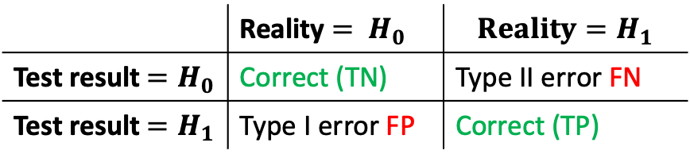
 | Reality $= H_{0}$ | $${Reality=H}_{1}$$
Test result $=H_{0}$ | Correct (TN) | Type II error FN
Test result ${=H}_{1}$ | Type I error FP | Correct (TP)
Fisher’s Exact Test
6 people
Took medicine
6 people
Took placebo
after 1 month
3 cured , 3 not cured
50% of people got cured
after 1 month
2 cured, 4 not cured 33% of people got cured
Observation: $P\left(observing above or more extreme results |H_{0}\right)≫ 0.05$
Claim: Reject the Null Hypothesis
What type of error happens in above scenario if we reject the null hypothesis?
Note: To avoid Type I errors, we reject H0​ only when $P−value≤α$.
fasgarinejad@ucsd.edu Slide 26 of 30 January 21, 2025
Notes:
type 1 error because in reality h0 holds true, however we have accepted h1. there’s no strong evidence against H0H_0H0​. Rejecting H0 here would be incorrect.
To avoid Type I errors, we reject H0​ only when P≤α.
The Fisher's exact test is used to test whether there is a significant association between two categorical variables in a 2x2 contingency table. It is particularly useful when sample sizes are small, and the assumptions for other tests (like the chi-squared test) are not met.
when we want exact probabilities.
For large samples, Fisher's test can be computationally intensive, and the chi-squared test often gives similar results.Fisher's test is more conservative and may have less power in large datasets.

Slide 27
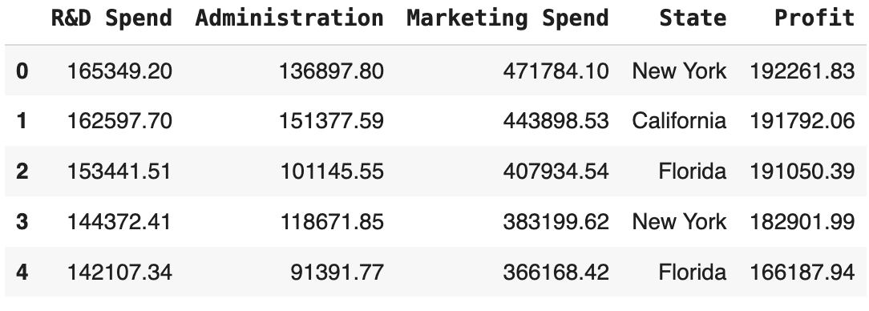
A P-Value use-case in Data Science Feature Selection
from 50_Startups dataset
Fit a multiple Linear Regression to the data:
$$Profit=R\&D spend∗C_{1} + Administraion ∗C_{2} +Marketing Spend∗C_{3} + State ∗C_{4}+ \\ β (intercept)$$
Which features are unlikely to contribute significantly to the Profit prediction?
fasgarinejad@ucsd.edu Slide 27 of 30 January 21, 2025
Notes:
from 50_Startups dataset contains financial and location data of 50 startups, used to predict their profit based on R&D, administration, marketing expenses, and state.
https://colab.research.google.com/drive/1tleiMrN200ETEAuPVANHp1HvcHM-P07a?usp=sharing
https://pages.github.coecis.cornell.edu/info2950-s23/project-wondrous-raichu/report.html
showing a large dataset.
talking about linear regression.
asking if I can use all columns or not
discussing if the libraries in python and R use all or ignore some and how they do that.
discussing different ways you can get rid of some columns or keep the most important ones.
then discussing p-value, what it means for each column and for a given threshold, how do you decide to keep a variable or not. showing in the code

Slide 28
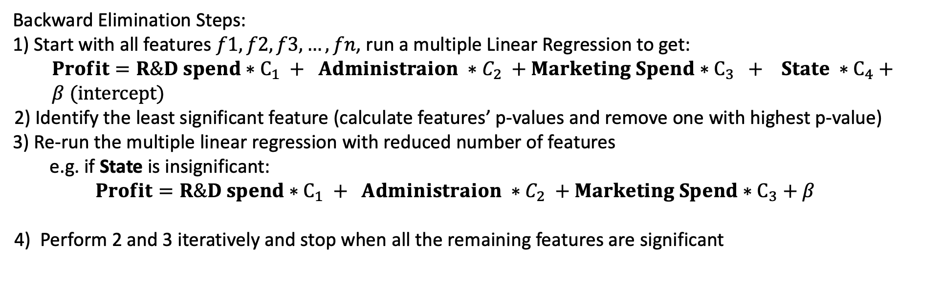
A P-Value use-case in Data Science Feature Selection
Backward Elimination Steps:
1) Start with all features $f1, f2, f3,…, fn$, run a multiple Linear Regression to get:
$$Profit=R\&D spend∗C_{1} + Administraion ∗C_{2} +Marketing Spend∗C_{3} + State ∗C_{4}+ \\ β (intercept)$$
2) Identify the least significant feature (calculate features’ p-values and remove one with highest p-value)
3) Re-run the multiple linear regression with reduced number of features
e.g. if State is insignificant: $$Profit=R\&D spend∗C_{1} + Administraion ∗C_{2} +Marketing Spend∗C_{3}+β$$
4) Perform 2 and 3 iteratively and stop when all the remaining features are significant
How do we calculate P-value for each feature?
fasgarinejad@ucsd.edu Slide 28 of 30 January 21, 2025
Notes:
above a chosen significance level, e.g., 0.05
https://colab.research.google.com/drive/1tleiMrN200ETEAuPVANHp1HvcHM-P07a?usp=sharing
https://pages.github.coecis.cornell.edu/info2950-s23/project-wondrous-raichu/report.html
showing a large dataset.
talking about linear regression.
asking if I can use all columns or not
discussing if the libraries in python and R use all or ignore some and how they do that.
discussing different ways you can get rid of some columns or keep the most important ones.
then discussing p-value, what it means for each column and for a given threshold, how do you decide to keep a variable or not. showing in the code

Slide 29
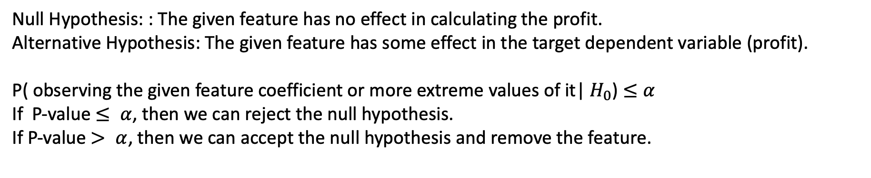
A P-Value use-case in Data Science Feature Selection
How do we calculate P-value for each feature?
Null Hypothesis: : The given feature has no effect in calculating the profit.
Alternative Hypothesis: The given feature has some effect in the target dependent variable (profit).
P( observing the given feature coefficient or more extreme values of it| $H_{0}$) $≤α$
If P-value $≤ α$, then we can reject the null hypothesis.
If P-value $> α$, then we can accept the null hypothesis and remove the feature.
fasgarinejad@ucsd.edu Slide 29 of 30 January 21, 2025
Notes:
This means that, assuming the feature has no effect (null hypothesis), there is a 3% chance of observing a feature coefficient at least as extreme as the one you found in the data.
https://colab.research.google.com/drive/1tleiMrN200ETEAuPVANHp1HvcHM-P07a?usp=sharing
https://pages.github.coecis.cornell.edu/info2950-s23/project-wondrous-raichu/report.html
showing a large dataset.
talking about linear regression.
asking if I can use all columns or not
discussing if the libraries in python and R use all or ignore some and how they do that.
discussing different ways you can get rid of some columns or keep the most important ones.
then discussing p-value, what it means for each column and for a given threshold, how do you decide to keep a variable or not. showing in the code

Slide 30

Exit Ticket – Due Saturday at 23:59 PM
fasgarinejad@ucsd.edu Slide 34 of 34 January 21, 2025
Notes:
pedagogical tools

Slide 31
Resources
Fundamentals of Statistics and Probability, Sharif University of Technology, Professor Ali Sharifi Zarchi
Statistics and Data Science, UC San Diego, Professor Alon Orlitsky
fasgarinejad@ucsd.edu Slide 1 of 30 January 21, 2025
Notes:
The phrase "95% confidence" refers to the confidence we have in our decision to reject the null hypothesis, not the confidence in the null hypothesis itself being false. It means that if we were to repeat the experiment many times under the same conditions, we would expect to make the correct decision (reject the null hypothesis when it is false) 95% of the time.

Slide 32
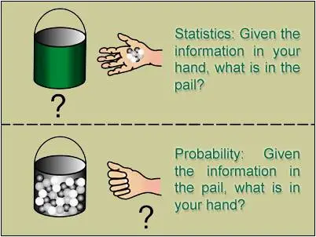
When do we use statistics?
Probability: Given the information in the pail, what is in your hand?
Statistics: Given the information in your hand, what is in the pail?
image source: https://teachingstatisticsandprobability.wordpress.com/
fasgarinejad@ucsd.edu Slide 5 of 34 January 21, 2025
Notes:
the big question is, when do we use statistics and when do we use it. if you have information about a population, here for instance you know how many black, gray and white balls arin this pail, you can easily calculate how probable it is to observe a subset of that population. for instance if there are 20 black,…, the probability of observing 2 black, 3 white and 1 gray balls can be calculated. For instance, if I have measured height of all people in the usa, then I’ll have a distribution of their heights, ….
but it is not the case that you always have information about the whole population.

Slide 33
A P-Value use-case in Data Science Feature Selection
How do we calculate P-value for each feature?
Null Hypothesis: : The given feature has no effect in calculating the profit.
Alternative Hypothesis: The given feature has some effect in the target dependent variable (profit).
P( observing the given feature coefficient or more extreme values of it| $H_{0}$) $≤α$
If P-value $≤ α$, then we can reject the null hypothesis.
If P-value $> α$, then we can accept the null hypothesis and remove the feature.
fasgarinejad@ucsd.edu Slide 5 of 34 January 21, 2025
Notes:
This means that, assuming the feature has no effect (null hypothesis), there is a 3% chance of observing a feature coefficient at least as extreme as the one you found in the data.
https://colab.research.google.com/drive/1tleiMrN200ETEAuPVANHp1HvcHM-P07a?usp=sharing
https://pages.github.coecis.cornell.edu/info2950-s23/project-wondrous-raichu/report.html
showing a large dataset.
talking about linear regression.
asking if I can use all columns or not
discussing if the libraries in python and R use all or ignore some and how they do that.
discussing different ways you can get rid of some columns or keep the most important ones.
then discussing p-value, what it means for each column and for a given threshold, how do you decide to keep a variable or not. showing in the code

Slide 34
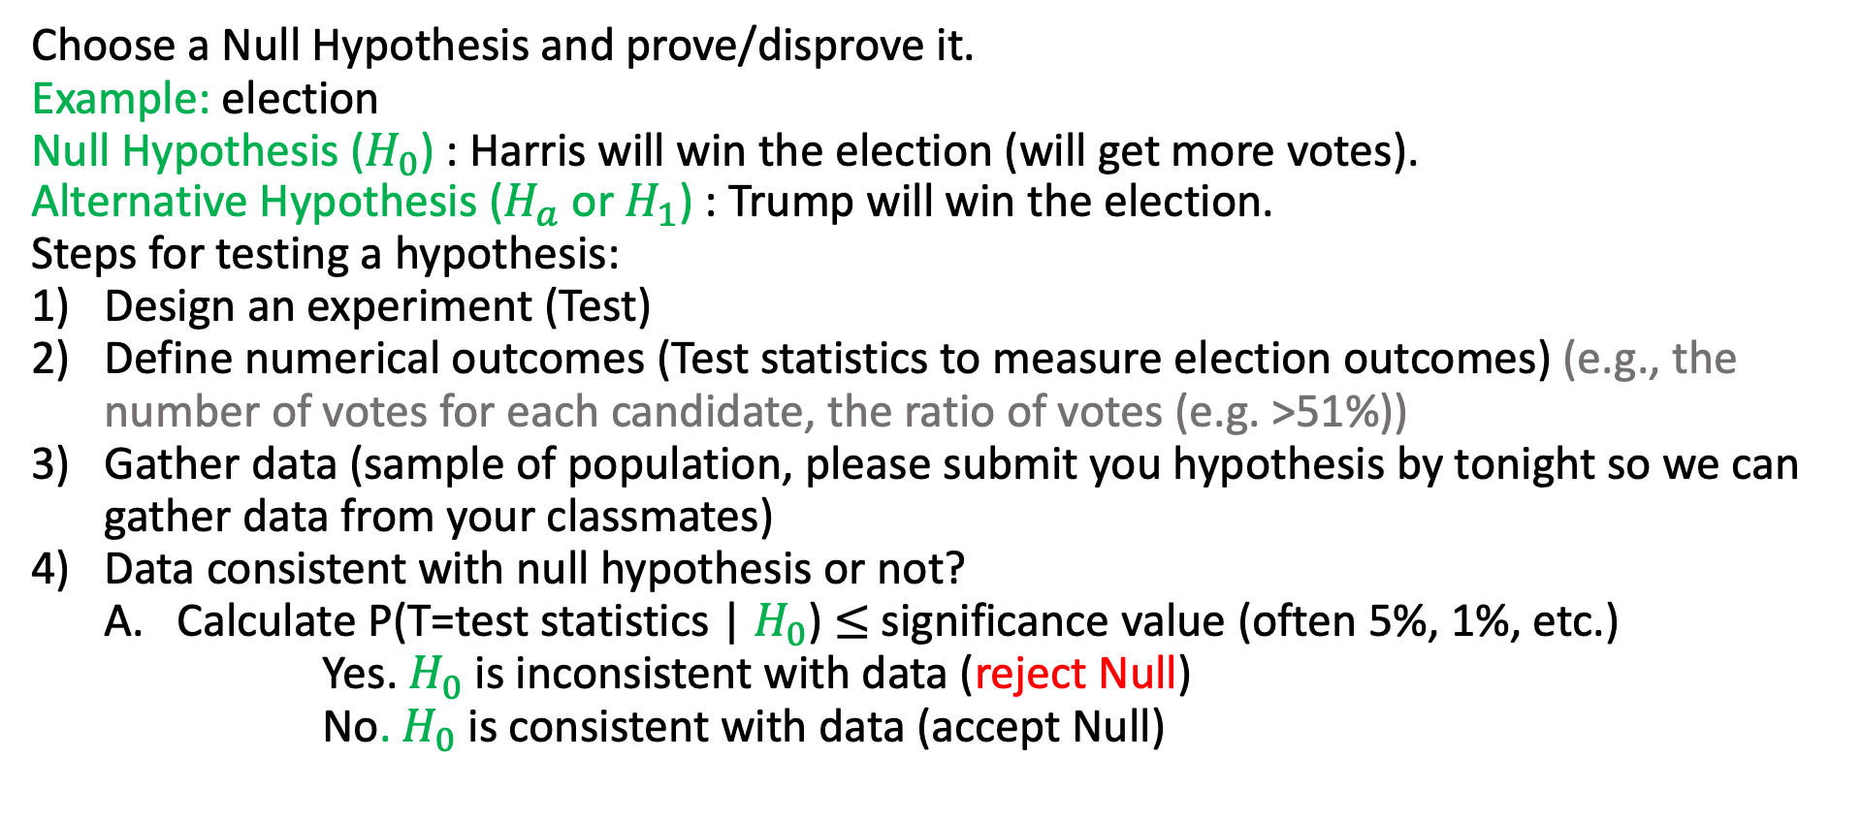
HW bonus question: Testing a hypothesis about a population
Choose a Null Hypothesis and prove/disprove it.
Example: election
Null Hypothesis ($H_{0}$) : Harris will win the election (will get more votes).
Alternative Hypothesis ($H_{a}$ or $H_{1}$) : Trump will win the election.
Steps for testing a hypothesis:
Design an experiment (Test)
Define numerical outcomes (Test statistics to measure election outcomes) (e.g., the number of votes for each candidate, the ratio of votes (e.g. >51%))
Gather data (sample of population, please submit you hypothesis by tonight so we can gather data from your classmates)
Data consistent with null hypothesis or not?
Calculate P(T=test statistics | $H_{0}$) $≤$ significance value (often 5%, 1%, etc.)
Yes. $H_{0}$ is inconsistent with data (reject Null)
No. $H_{0}$ is consistent with data (accept Null)
fasgarinejad@ucsd.edu Slide 5 of 34 January 21, 2025

Slide 35
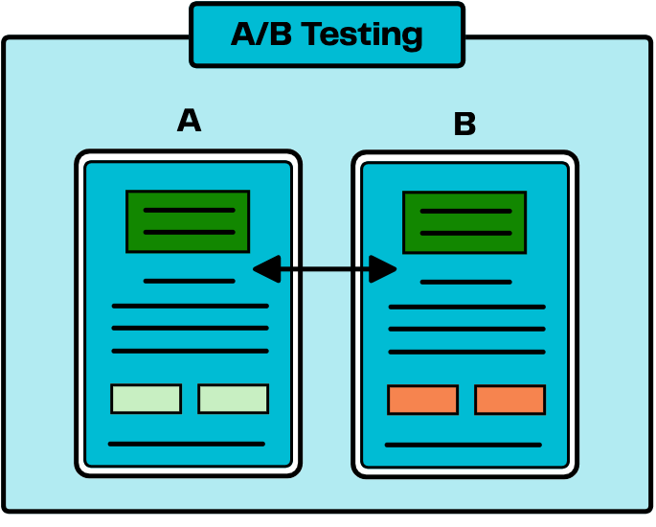
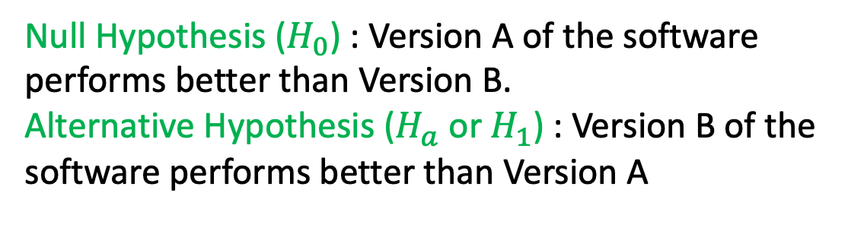
HW bonus question example
Practical Use Cases of Hypothesis Testing (A/B Test)
We want to determine which version of our software performs better. We test a sample of users and estimate the preferred version based on their behavior or feedback before the final release.
Null Hypothesis ($H_{0}$) : Version A of the software performs better than Version B.
Alternative Hypothesis ($H_{a}$ or $H_{1}$) : Version B of the software performs better than Version A
fasgarinejad@ucsd.edu Slide 5 of 34 January 21, 2025

